Slide 1
Sentiment & prediction CHAT BOT
GROUP 2: ALI, HAIDER, TEJAS, AMEER, JAVIER
FINTECH BOOTCAMP, UNIVERSITY OF TORONTO
SEPTEMBER 2022

Slide 2
AGENDA
Objective - Ali
Application Design - Javier
Sentiment Analysis - Ameer
Prediction ML Model - Haider
Delivery: Chatbot Simulation - Tejas
Insights & Next Steps - Ali
Business Objective:
To provide trading guidance for selected Stocks and Crypto-coins based on data, market sentiment and prediction
Technology Objective:
To develop an application that will integrate sentiment analysis and ML prediction modeling with AWS’ Lex and Lambda

Slide 3
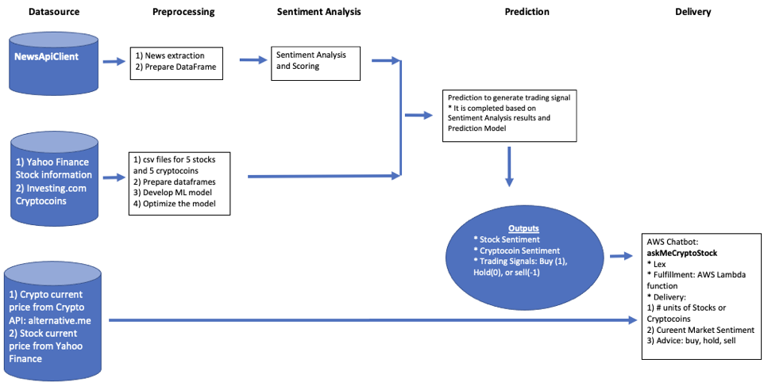
Application design

Slide 4
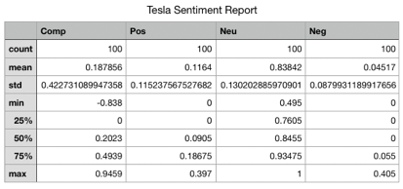
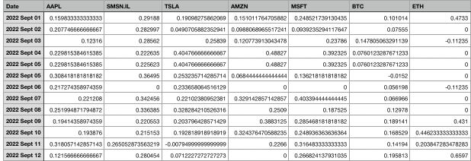
SENTIMENT ANALYSIS
Import libraries: NewsApiClient, SentimentIntensityAnalyzer, NewsApiClient, others.
Extract News for Stocks: and Crypto-coins
Complete Sentiment Article Analysis
Develop Sentiment Report
Identify Sentiment Signal
Composite Sentiment to Sentiment Signal
Composite Sentiment > 0.3 , then Sentiment Signal = 1
Composite Sentiment <=0.3, then Sentiment Signal = -1

Slide 5
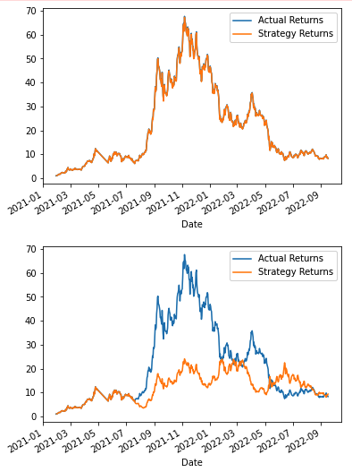
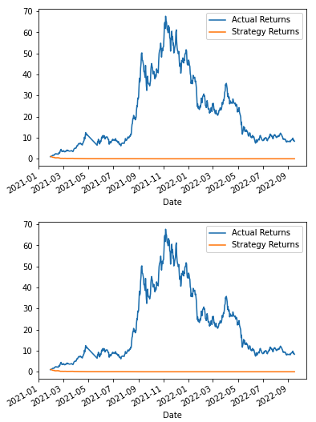
PREDICTION signal
Stocks | Crypto-coins
Amazon, Apple, Microsoft, Samsung, Tesla | Bitcoin, Cardano, Dogecoin, Ethereum, Solana
Import libraries: SVM, StandardScaler, Classification_Report
Extract CSVs with Open, Close price historical data for 5 years
Develop Signals Dataframe with Close price, Actual returns, SMA_Fast, SMA_Slow, Strategy Returns
Split the data, train the model(s)
Complete Trading Signal Prediction
Identify Future Trading Signal
Combined Signal = Sentiment Signal + Future Trading Signal
SVM
ADA
BLR
DTC
Future Trading Signal
Actual Returns >= 0 , then Future Trading Signal = 1
Actual Returns < 0 , then Future Trading Signal = - 1

Slide 6



DELIVERY – chatbot SIMULATION
Tesla?, no Elon is too distracted
Umm?, the Merge
Hello, I am thinking about buying Stocks or Cryptocoins
I can help with Stocks: Amazon, Apple, Microsoft, Samsung, Tesla or Cryptocoins: Bitcoin, Cardano, Dogecoin, Ethereum, Solana
Function: Validation for Stock or Cryptocoin selection
Function: Get current price from API Alternative.me:
1 Ether = C$ 1,804
2.21483 Ethers for C$ 4,000
Function: Get Market Sentiment from Sentiment Analysis:
Market Sentiment = 0.312, then : +1 = BUY
Function: Get Future Signal from Prediction Model:
Future Signal is +1, then “BUY”
Other AWS functions: handler, dispatch, etc.
Ok, I want to buy Ethereum
How many dollars do you have for it?
$4,000
You can buy 2.21483 Ethers. The Market Sentiment is favorable to “BUY” and my Model predicts a “BUY” trading signal
This is just information I can provide, not financial advice. Do you want to ask about any other one?
No, that’s it
Thank you!

Slide 7
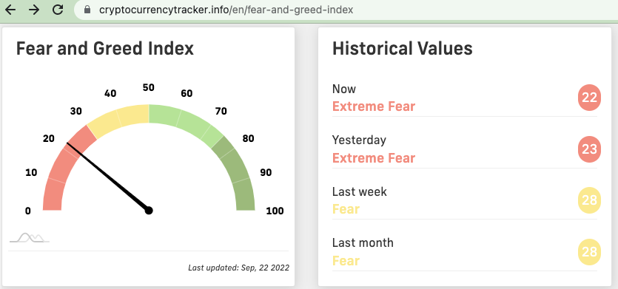
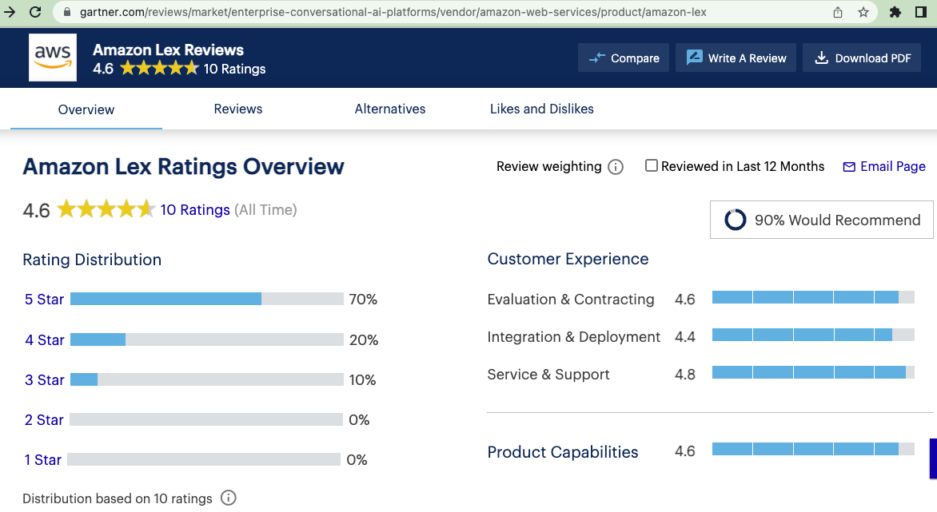
Insights & next steps
Sentiment Analysis tends to be short term biased generally. Retrieving more historical data and more sources mitigates the bias. This project tested to additionally get sentiment from Tweets; however, the re-tweets are difficult to be filtered out
AWS Lex provides built-in features; however, to run the python coding in Lambda demands substantial coding to import libraries, connect with APIs(pending) and external data sources(pending)

Slide 8
Questions?
Thank you!

